Slide 1
MALL MANAGEMENT

Slide 5
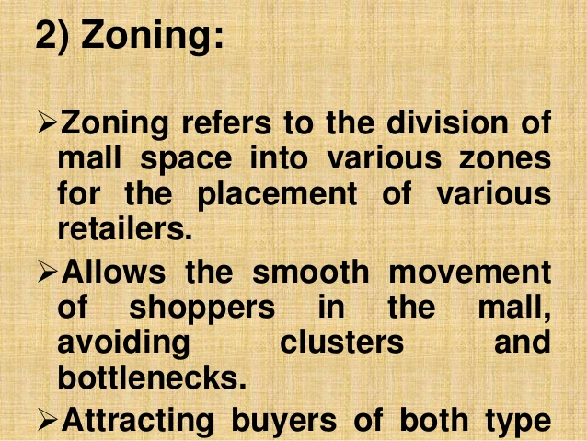

Slide 8
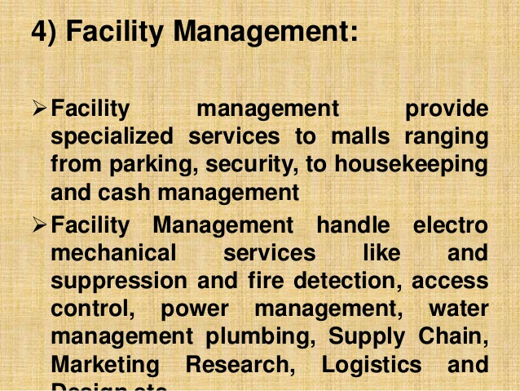

Slide 9
